Slide 1

COMPILER FOR LANGUAGE LEARNING GAMES
Presented By:
Name: M. Sana Fathima
Reg no: 192371082
Course Code: CSA1452
Course Name: Compiler Design for Industrial Automation
Date :03/04/2025

Slide 2
INTRODUCTION
Language learning games provide an engaging way to develop linguistic skills, but creating such games requires an efficient compiler that can process game scripts, validate linguistic structures, and optimize performance.
This paper explores the development of a specialized compiler designed for language learning games, focusing on syntax processing, interactive feedback, and adaptability to multiple languages.

Slide 3
ABSTRACT
A compiler for language learning games must handle grammar verification, provide real-time corrections, and support multilingual environments.
This study presents a solution that integrates natural language processing (NLP) with compiler design, allowing interactive learning experiences through instant feedback mechanisms.
We discuss architectural choices, implementation strategies, and future enhancements to improve compiler efficiency and user engagement.
.

Slide 4
Problem Statement
Traditional compilers focus on standard programming languages, but they lack support for processing linguistic structures required in language learning applications. Existing game development frameworks do not offer syntax validation or real-time feedback for language learners, limiting their effectiveness.
Solution
A dedicated compiler for language learning games can process game scripts while validating grammatical correctness and structure. By incorporating NLP techniques, the compiler can analyze user inputs, suggest corrections, and optimize content for better engagement. The proposed compiler will include:
• Grammar-aware parsing: Checking for syntax correctness in multiple languages.
• Interactive feedback: Providing real-time corrections and suggestions.
• Performance optimization: Ensuring smooth execution of language-learning scripts.

Slide 5
Scope
This project is designed for educators, developers, and learners who aim to create and use interactive language learning games. The compiler will support multiple languages and integrate with existing game engines, making it suitable for a wide range of applications, from beginner to advanced learners.
Objectives
1. Develop a compiler that can parse and validate language-learning scripts.
2. Implement NLP techniques to provide real-time grammatical feedback.
3. Ensure multilingual support for a diverse learning experience.
4. Optimize performance for seamless gameplay.
5. Enhance user engagement through interactive query handling.

Slide 6
ARCHITECTURE
The compiler follows a modular design, consisting of:
• Lexical Analyzer: Tokenizes input text, identifying words, phrases, and symbols.
• Syntax Analyzer: Checks the grammatical structure based on predefined language rules.
• Semantic Analyzer: Ensures contextual correctness, assisting learners in understanding language nuances.
• Intermediate Code Generator: Converts validated text into a format executable by language learning games.
• Optimization & Execution Engine: Enhances performance for real-time feedback and interactive gameplay.

Slide 7
Methodology
1. Requirement Analysis: Identifying key features needed for language learning games.
2. Design & Development: Implementing the core compiler functionalities, integrating NLP and interactive feedback.
3. Testing & Validation: Using sample scripts to test parsing accuracy and real-time response.
4. Optimization: Refining performance to ensure smooth execution within game environments.
Implementation
• Parsing Mechanism: A hybrid approach combining traditional compiler techniques with NLP models.
• Error Detection & Correction: Real-time grammar and syntax analysis using rule-based and AI-driven approaches.
• Multilingual Support: Utilizing NLP libraries like spaCy, NLTK, or Transformer models for diverse language handling.

Slide 8
Implementation Outcomes
• Accurate Syntax Analysis: The compiler effectively identifies and corrects grammatical mistakes.
• Real-time Feedback System: Learners receive instant suggestions for improvement
• Smooth Game Integration: Developers can seamlessly embed the compiler into their game engines.
• Enhanced Engagement: Interactive query handling allows dynamic learning experiences.

Slide 9
Future Enhancements
• AI-driven Personalized Learning: Adapting feedback based on individual learning styles.
• Voice Recognition & Processing: Allowing spoken input for immersive language learning.
• Augmented Reality (AR) Integration: Enhancing real-world language learning interactions.
• Gamification Features: Introducing adaptive difficulty levels based on learner progress.

Slide 10
Technological Advancements
With the rise of AI and NLP, compilers for language learning games can leverage:
• Machine Learning Models for context-aware error correction.
• Cloud-based Compilation for enhanced accessibility and real-time updates.
• Interactive AI Assistants to guide learners through complex grammar rules.
Interactive Query Handling in Compilers
Traditional compilers operate in a static manner, but interactive compilers enable real-time query resolution. Features include:
• On-the-fly corrections: Identifying and fixing errors as users type.
• Natural Language Queries: Allowing users to ask syntax-related questions within the game.
• Context-aware Suggestions: Providing hints based on learner history and progress.

Slide 11
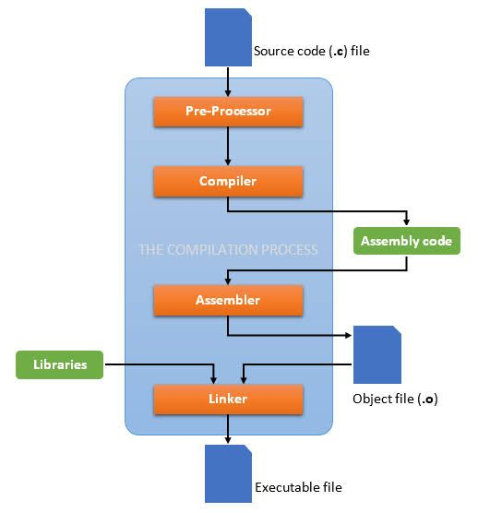
Flow Chart

Slide 12
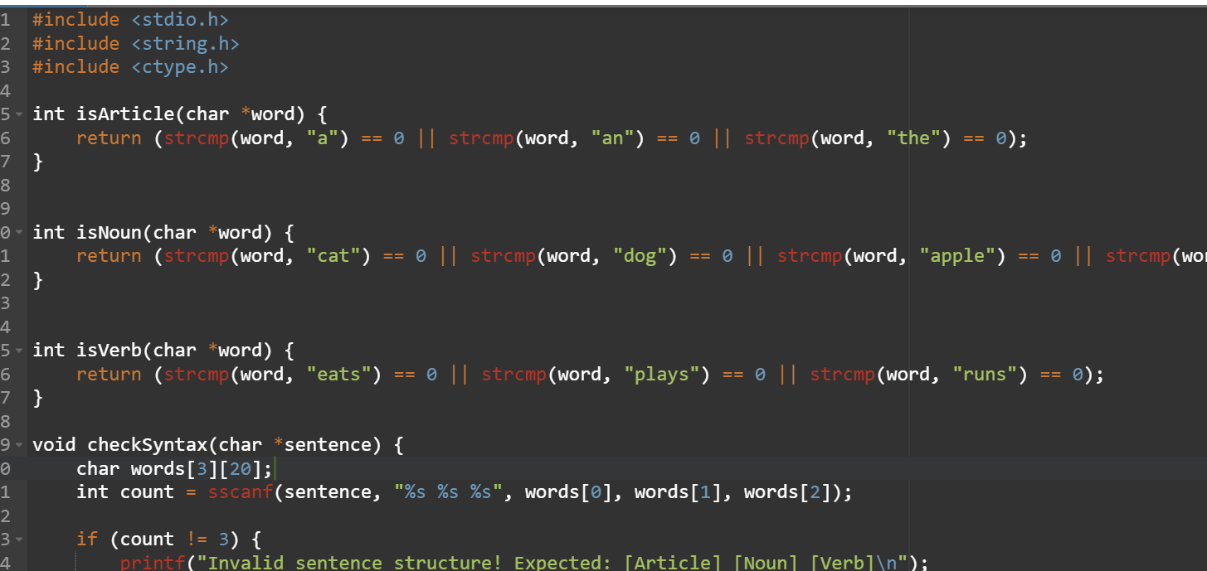
Code implementation

Slide 13
Conclusion
A compiler tailored for language learning games bridges the gap between traditional language instruction and interactive digital experiences
By incorporating NLP, AI-driven analysis, and interactive query handling, this project aims to make language learning more engaging, effective, and accessible.
Future advancements will further enhance adaptability and personalization, making this a crucial tool in modern educational technology.

Slide 14
References
Bird, S., Klein, E., & Loper, E. (2009). Natural Language Processing with Python: Analyzing Text with the Natural Language Toolkit. O'Reilly Media.
Jurafsky, D., & Martin, J. H. (2023). Speech and Language Processing (3rd ed.). Pearson.
Mikolov, T., Sutskever, I., Chen, K., Corrado, G. S., & Dean, J. (2013). Distributed representations of words and phrases and their compositionality. Advances in Neural Information Processing Systems, 26, 3111–3119.
Manning, C. D., Raghavan, P., & Schütze, H. (2008). Introduction to Information Retrieval. Cambridge University Press.
Goldberg, Y. (2017). Neural network methods for natural language processing. Synthesis Lectures on Human Language Technologies, 10(1), 1-309.

